Slide 1

PROCESS FLOW
2018

Slide 2


USER INTERFACE
2018

Slide 3
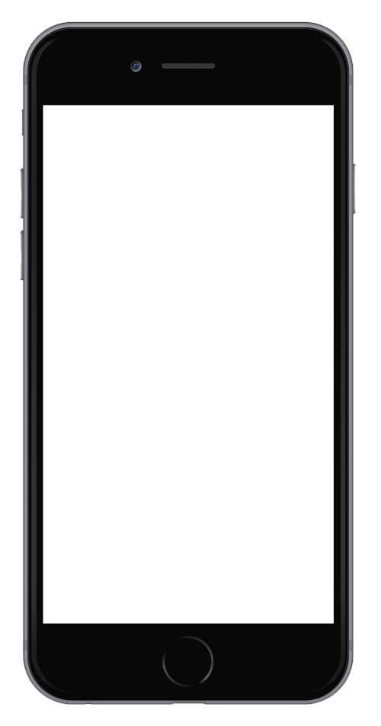

0.Splash screen
Logo appears 3-5 seconds as the app loads

Slide 4
1.Intro Screen
Two action buttons A and B
Hyperlink on C
A
Login
I’m a business
B
C
If you don’t have an account, register

Slide 5
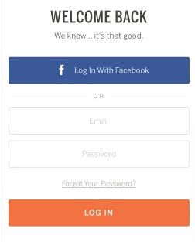
1A. Login Screen
Two action buttons A and B
Hyperlink on C
Button A: Pop-up facebook login asking for access to facebook app or If no facebook app redirect to facebook log in page (web)
Button B: verify email and password and log in
Error message if email and/or password are wrong
Button C: Redirect to “recover password“ page
A
And Instagram
C
B

Slide 6
1B. Login Screen - Business
Manage your Reservations
Two action buttons A and B
Hyperlink on C
Button A: Pop-up facebook login asking for access to facebook app or If no facebook app redirect to facebook log in page (web)
Button B: verify email and password and log in
Error message if email and/or password are wrong
Button C: Redirect to “recover password“ page
A
And Instagram
C
B

Slide 7
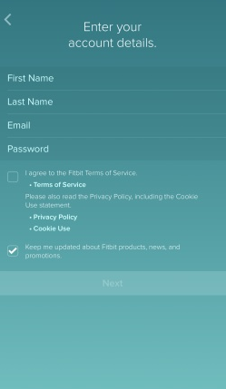
1C. Register Screen - User
BUSINESS
USER
Separated into two tabs: Register for “Users” and “Business”

Slide 8
1C. Register Screen - Business
USER
BUSINESS
Fill in:
Name of Salon
No. of employees
Address
Phone Number
Owner’s name
Email
Password
Submit photo (proof of ownership)
Separated into two tabs: Register for “Users” and “Business”
After business owner registers, it’s required to submit a proof of ownership (utility bill e.g.) and our team will validate all submissions personally prior to acceptance
Disclaimer: Vannity asks phone and address to verify the salon’s identity when joining our network

Slide 9
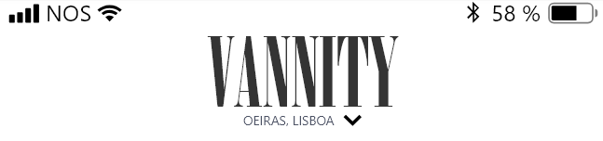
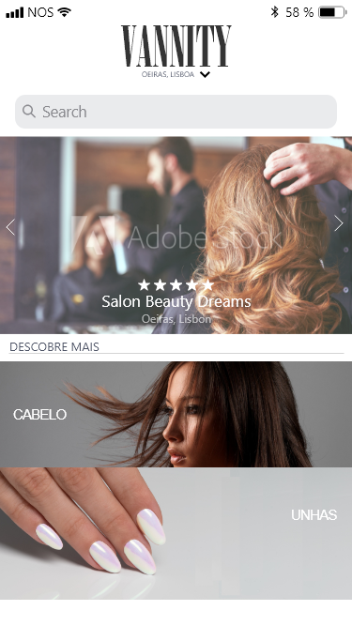




2. Home Screen (Left button)
A
B
A (Location):
Asks permission to detect location automatically
By Clicking the user can change the location manually to a preset list of locations
B (Search Bar):
By taping the search bar the user goes into a search menu (pop down)
C (Featured Salons):
Side scroll list with images background, salon rating, name and location
D (Types of Services):
Hyperlink to sortings lists of salons by service type We intend to have X services: Hair, nails, hair removal, Aestethics, Massage, Makeup, Barber & Male Grooming, Spa and Freelancer
C
D

Slide 10
2B. SEARCH BAR
By taping the search bar the user goes into a search menu (pop down)
Priority of search is:
Prioritizes results in the current location
Searches keywords in fields “Location”, “Salon Name” and “Service type”.
If more than one word is used for search, prioritizes the AND logic (“Salon” AND “Hair” (1+2) instead of “Salon” OR “Hair” (1 or 2))
Sort Option by: Location Proximity, Salon Rating
Filters:
Accepts ATM payment
In-app booking
Type of service
By rating
Open now
Open on weekends
Price

Slide 11
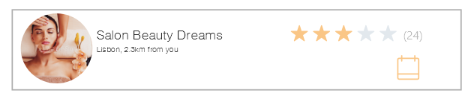
3. Booking Screen
MY APPOINTMENTS
A
CURRENT
PREVIOUS
FAVORITES
A (My appointments tab):
Current:
List with details for current bookings:
Service type, Salon name, Date, Time, Employee, Total Cost
Previous:
List with details for previous bookings:
Service type, Salon name, Date, Time, Employee, Total Cost
Favorites:
List with salon’s names with visual similar to search results

Slide 12
4. Near me (3rd button – left tab)
NEAR ME
YOUR CIRCLE
Automatically searches and displays:
List with salons nearby:
Service type, Salon name, Date, Time, Employee, Total Cost
Priority of search is:
Prioritizes results in the current location
Searches keywords in fields “Location”, “Salon Name” and “Service type”.
If more than one word is used for search, prioritizes the AND logic (“Salon” AND “Hair” (1+2) instead of “Salon” OR “Hair” (1 or 2))
Sort Option by: Location Proximity, Salon Rating
Filters:
Accepts ATM payment
In-app booking
Type of service
By rating
Open now
Open on weekends
Price

Slide 13
4. Your Circle (3rd button – right tab)
NEAR ME
YOUR CIRCLE
A: Your connections
List with salons recently commented by other users that you follow
Salon name, Date, given classification and comment Friend name and friend picture on the circle picture
B: You might also like
List with salons recently commented by other users that have high scores
Salon name, Date, given classification and comment
High score iser name and friend picture on the circle picture
Booking icon: redirects user to the salon page USER name and picture: redirects to that user profile page
Your Connections
A
B
You might also like

Slide 14
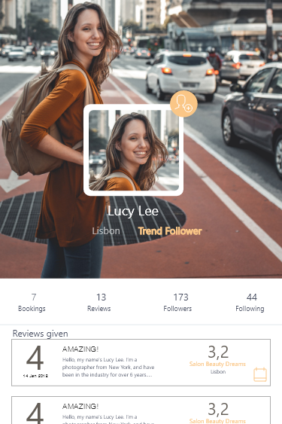
5. User Profile
A
A: User can follow another user
B and C: User can change profile and background photos
D: Username, User Location and User Profile Level (Gamification Scores and categories – to be determined)
E: Display bar with:
First: Number of bookings done in the app
2nd: Number of comments submitted about salon’s
3rd: Number of followers
4rd: Number of following
F: Previous comments given by the user (details self explanatory in the image)
B
D
C
E
F

Slide 15
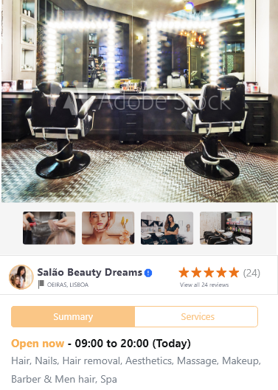
6. Business Profile
A
A and B: Salon can choose the Principal Picture, small picture (avatar) nd add others to its profile
C: Based on the schedule provided by the Saloon, the app will present “Open now” or “Closed now”. This schedule can be edited anytime by the salon
D: The salon will have to choose what type of services it provides in order for the Sortings List to categorize it correctly.
B
C
D

Slide 16
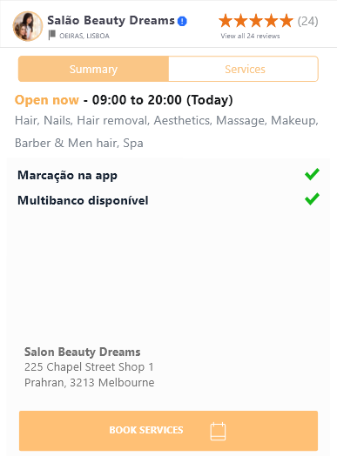
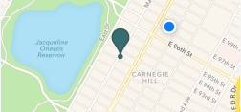
6. Business Profile (scrolled down)
A: By scrolling down, the saloon can mark its available features such as “In-app booking available”, “Card payment available”,
B: Based on the address introduced, a preview map will appear in the Summary tab, if the user clicks it it can redirect to Google Maps, Iphone Maps, Waze, etc.
C: Clicking on “Book Services” while on the Summary tab will redirect to the Services tab.
A
B
C

Slide 17
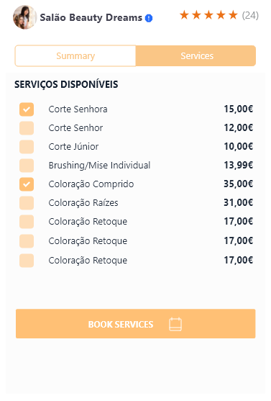
6. Business Profile – Services tab
A: Saloons can edit the services they have available, and in each service, the salon will have to fill:
Type of Service: Hair
Name of Service (to appear in app): Regular Haircut
Price: 15$
Employee who performs the service: ex. Adam, Mike, Rachel
Duration: e.g.45 Minutes
Small description (optional)
B: By clicking on Book Services when on the “Services tab” It will redirect to the scheduler
A
B

Slide 18
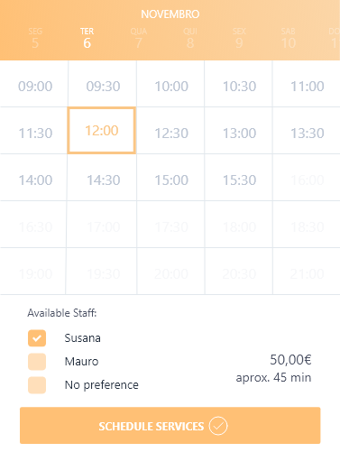
6. Business Profile – Services tab SCHEDULER
A
A: Saloons can edit the employees schedule and mark the available and busy hours in every day. Users also use this scheduler to book free periods.
B: Free and busy times will appear in different colours
B

Slide 19
7. Services List (e.g. Aesthetics)
A
F
AESTHETICS
Everytime you pick a service from the “2. Home Screen (Left button)” you are automatically redirected to a services list screen just like this example
A (Location):
location automatically detected in the home screen
By Clicking the user can change the location manually to a preset list of locations
B (Search Bar):
By taping the search bar the user goes into a search menu (pop down)
C (Featured Salons):
Side scroll list with images background, salon rating, name and location (might be different featured from the home screen)
D (salons with that service listing):
Lists each bar as a salon with details of: Salon name, Distance to current location, salon location name, salon rating, icon of book now (if possible to book in the app), minimum service price
E (Filter and Sort By):
By taping the Filter the user goes into a filter menu (pop down)
By taping the sort by, the user chooses between DISTANCE, RATING and minimum service price
F (Service choosen):
Just the name of the picked service so that the user knows what he picked (in this case example is AESTETHICS)
B
C
Fillter
Sort By
E
D

Slide 20

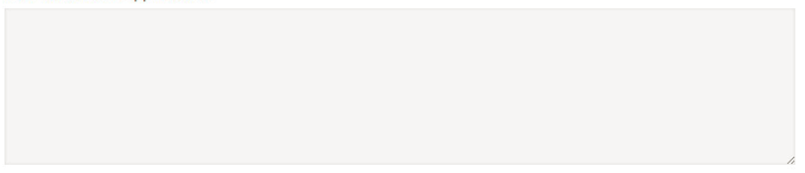
8. Feedback screen
This screen is mandatory after completing any booking in the app
Stars rating are are mandatory
Comment is optional
Possibility to add stickers in the future
This screen might be revisited in the “3. Booking Screen” in the “previous” tab but only if no comment has been inserted
A: Visited saloon stats (current rating, saloon name, saloon location, date and time of the visit)
B: mandatory to rate the experience
C: Optional to leave a comment
Submit button only accepts if stars are attributed and cannot change screen until a rating is given
A
Please rate your experience (mandatory)
B
Leave your comment (optional)
C
SUBMIT

Slide 21
Remarks
We only need the Portuguese language for now (but we want the possibility to add languages in the future)
In the future we want to gather analytics from the business owners (eg. Hours booked per employee, revenue per employee, most requested services, most cancelations, hours in which users perform more bookings… )
Each saloon service has 5 defining characteristics ( service name, service type. Price, duration and employee performing)
Services available might be edited by the saloon itself (business owner)
Business accounts need to pass by a validation process prior to be active (eg. Receive electric bill)
Logical checking in place when booking a service (cross reference if the service vs availability of worker that performs service works)
Gamification specs to be defined (user gets points per comments given and changes his status according to the points – TBD)
ADDITIONAL NOTES:
Calculate minimum value per service (further explanation required)
Free editable code
Revision of Bugs (free period duration?)

Slide 22

BUSINESS INTERFACE (TBD)
2018

